Slide 1
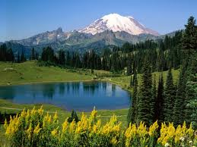
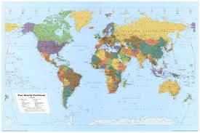
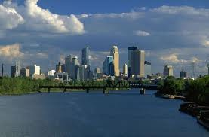
Geography
What is it?
Notes:
Ask students to define it in their own words. Next, distribute the Six Essential Elements Guided Notes and the Six Essential Elements chart and packet of the Elements. Put the students into pairs and as the italicized questions are reached have students discuss these in pairs before moving to a whole-class discussion.

Slide 2
Geography is:
“The study of people, places, and the environment.”
“A science that deals with the description, distribution, and interaction of the diverse physical, biological, and cultural features of the earth’s surface.”
Notes:
1st definition is very basic. The 2nd definition is more explicit and lays the groundwork for the introduction of the Six Essential Elements as a set of tools used to make sense of our world.

Slide 3
How is Geography Useful?
Notes:
Have students share responses to the above question and then show the video “Why Geography Matters” from Google Earth – available at http://www.cleanvideosearch.com/media/action/yt/watch?videoId=PPGuhJe6Qao

Slide 4
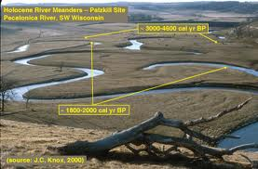
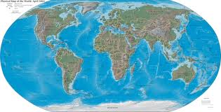
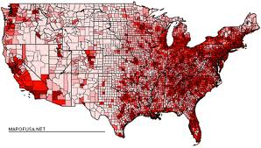
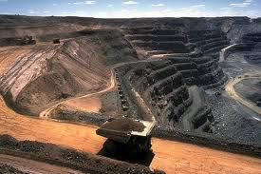
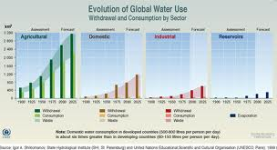
Geography
Has Six Essential Elements-
Notes:
Ask students why it is useful to break information down into categories.

Slide 5
1st - The World in Spatial Terms

Slide 6
The World in Spatial Terms
Maps and other geographic tools to get information from a spatial perspective.
Uses mental maps to organize information about people, places, and environments spatially.
Analysis of this information.
Notes:
At its most basic, this element is mapping. Refer to the chart and read aloud in the last box for The World in Spatial Terms the bulleted list. Have students look over the political map of the world and mark the items on the map from the list.

Slide 7
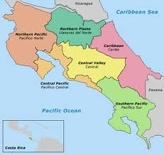
2nd – Places and Regions

Slide 8
Places and Regions
Physical and Human Characteristics of place
People create regions based on Earth’s complexity.
How culture and experience influence people’s perceptions of places and regions.
Notes:
Facilitate a brief discussion on how the region where your students live differs from other regions – for example, food the region is known for (grits in the South) based perhaps on what is farmed there, due to climate. Another example: Miami, FL is considered by Florida residents to be very different from Pensacola, FL although both are coastal cities in Florida. Why are they considered to be different? Refer to the map in their packet – why is “Wine Country” on the map? Use this to discuss concept of places/regions.

Slide 9
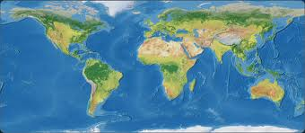
3rd – Physical Systems

Slide 10
Physical Systems
The physical processes that shape the pattern of the Earth’s surface
The characteristics and spatial distribution of ecosystems.
Notes:
Discuss how major storms like Hurricane Sandy can change coastlines; how climate change is resulting in higher ocean levels. Refer to the packet; how does this map apply to physical systems?

Slide 11
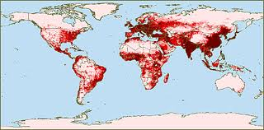
4th – Human Systems
Notes:
Ask students what they think is the purpose of this map. This is a population density map.

Slide 12
Human Systems
Characteristics, distribution, and migration of human population.
Characteristics, distribution, and complexity of earth’s cultural mosaics.
Patterns of economic interdependence.
Processes, patterns, and functions of human settlement.
Role of cooperation and conflict on Earth’s surface.
Notes:
Ask students why do people live where they do? Ask them why they live where they do – what originally brought their families to this place? Have them refer to the population density map in their packet – can they find their county? Why is population noticeably denser in the eastern United States than out west?

Slide 13
5th – Environment and Society

Slide 14
Environment and Society
Humans change the physical environment
Physical Systems affect Human Systems
Changes occur in the meaning, use, distribution, and importance of resources
Notes:
Referring to the packet’s 5th Element water scarcity map, ask students how water usage can affect migration and trade.

Slide 15
6th - Uses of Geography

Slide 16
Uses of Geography
To interpret the past
To interpret the present and plan for the future…
Notes:
Have students put a check by the “Things that (they) do that are geographic” – last page in the packet.

