Slide 1
Designing your own Restaurant
Mrs. Hayes

Slide 2
Congratulations!!!
You have decided to open your own restaurant!
You will work very hard these next couple classes to bring your ideas to light and make your dreams a reality!
Will people come to your restaurant?
What will people think of your establishment? Food? Wait staff? Location? Ambiance? Etc

Slide 3
First Step
Think of a CONCEPT
This frames the way the public perceives your entire establishment
It gives patrons an idea of what to expect when dining there.
It will shape your future decisions and investments, such as location, equipment purchases, number of employees and the kind of marketing strategy you will need.
When thinking about a concept, consider how the cuisine you offer will drive your business.

Slide 4
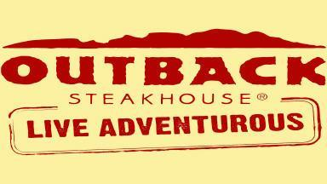
Decide on Cuisine
Decide whether you will serve a certain cuisine, such as ethnic food, fast food or comfort food, for example.

Slide 5
Cuisine
Think of all the areas and countries we studied this semester in Global & Gourmet Foods
What cuisine was most interesting? Inspiring? Flavorful?
What culture would you want to embrace and reflect in your restaurant menu, atmosphere, design and style?

Slide 6
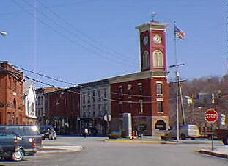
Determine Your Target Market
It is important to figure out if there is a substantial market for your concept in the area, as well as to set appropriate price points on your menu items.

Slide 7
Decide on an Operational Strategy
Plans for a new restaurant usually include an established service type.
Your restaurant will probably fall into basic service categories like the following:
Fine Dining
Casual Dining
Fast-Casual
Quick Service

Slide 8
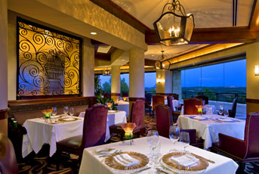
Fine Dining
Fine dining restaurants provide a high perceived value for their guests
Defined by beautiful décor
Pleasant atmosphere
Renowned chefs
Exceptional service
Special, pricy dishes.

Slide 9
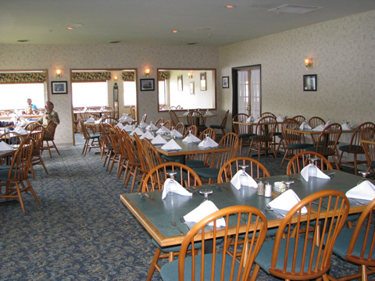
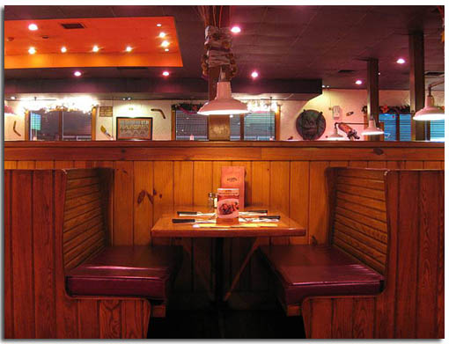
Casual Dining
Casual dining establishments offer full table service that is more upscale than fast-casual restaurants
More affordable than fine dining restaurants.
They appeal to a wide customer base and are usually family-friendly.

Slide 10
Fast-Casual
Also known as quick-casual and limited-service
Typically perceived to offer better food quality and improved service over quick-service places.
Their menus tend to be less extensive but also less expensive than casual dining restaurants.

Slide 11
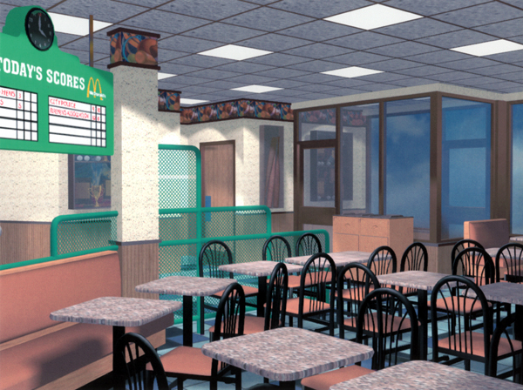
Quick-Serve
Make a business of convenience and speed of service.
These restaurants typically have simple décor, inexpensive food items and fast counter-service.
Most fast-food places fall into this category.

Slide 12
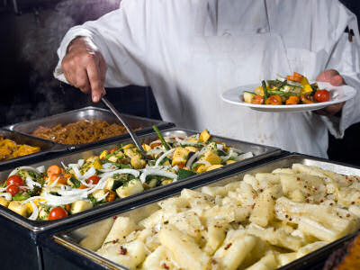
Addition Considerations
Layout of your restaurant
The employees you hire
The food you serve
Liquor licensing
Take-out
Delivery
Catering services

Slide 13
Atmosphere
Lighting- Dark and cozy? Bright and cheerful? Lots of windows? Black ceilings?
Seating- Booths? Intimate tables? Picnic Tables? Bar? Benches?
Flooring- Wood? Tile? Carpet?
Walls- Paint? Wallpaper? Memorabilia hung?
Music
Décor- Plants? Paintings? Advertisements?

Slide 14
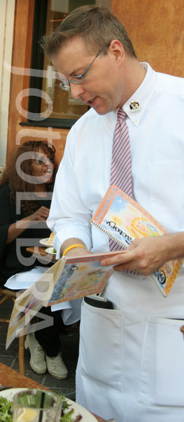
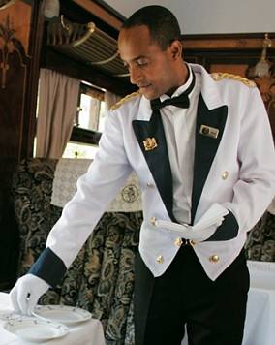
Employees
Uniforms?
Training
Formality
Quantity
Shifts
Leadership Opportunities
Floor Captain/Head Waitress
FOH Manager
BOH Manager

Slide 15
Name & Logo
What will your restaurant be named?
Ex: Jack’s Oyster House (what if establishment changed owners?)
Ex: Chuck E. Cheese (Serves cheesy pizza with a Mouse Mascot)
Name must match theme
Ex: Taco Bell (Serves tacos, burritos, nachos, etc)
Ex: Panera Bread (Serves homemade bread, café sandwiches, soups, salads)
What will be your logo? Where will you have it?
The Golden Arches

Slide 16
Restaurants
Examine the following slides
What is the restaurant theme?
What kind of atmosphere does it have?
What kind of food do they serve?
Who is their target market?
How much would you expect to pay for a meal?
Would you eat there? Have you eaten there?

Slide 17
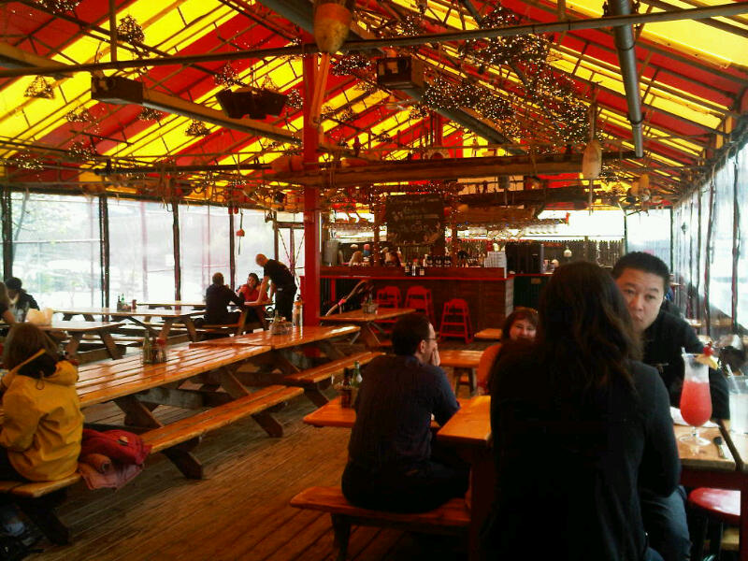
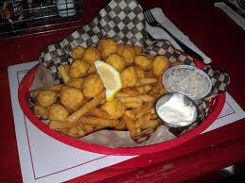
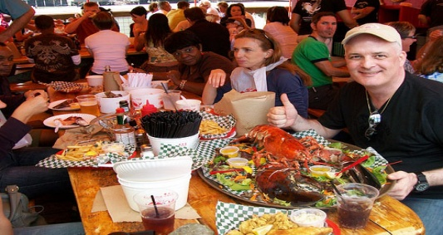
The Barking Crab, Boston MA
Buckets of Silverware, Straws and a Paper towel roll on Table
Picnic Tables- Outdoor seating

Slide 18
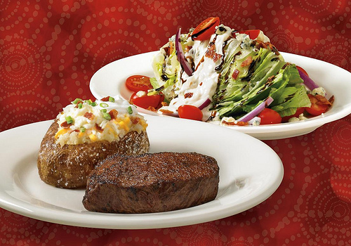
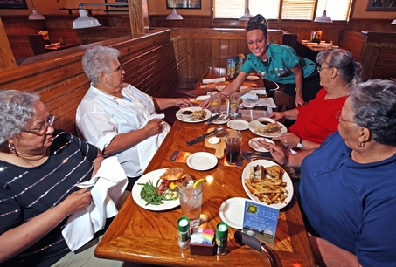
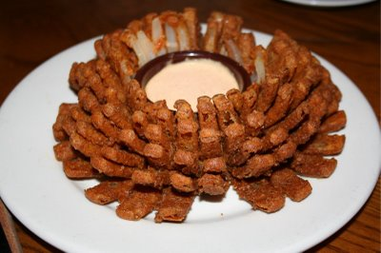
Outback Steakhouse

Slide 19
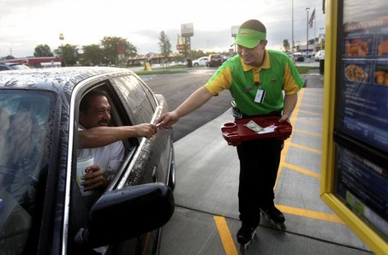
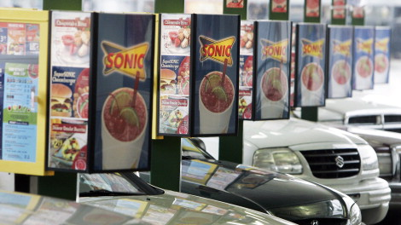
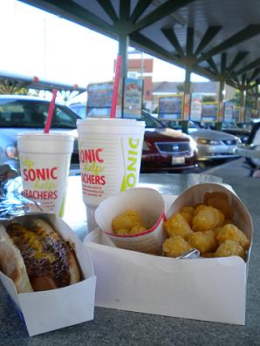
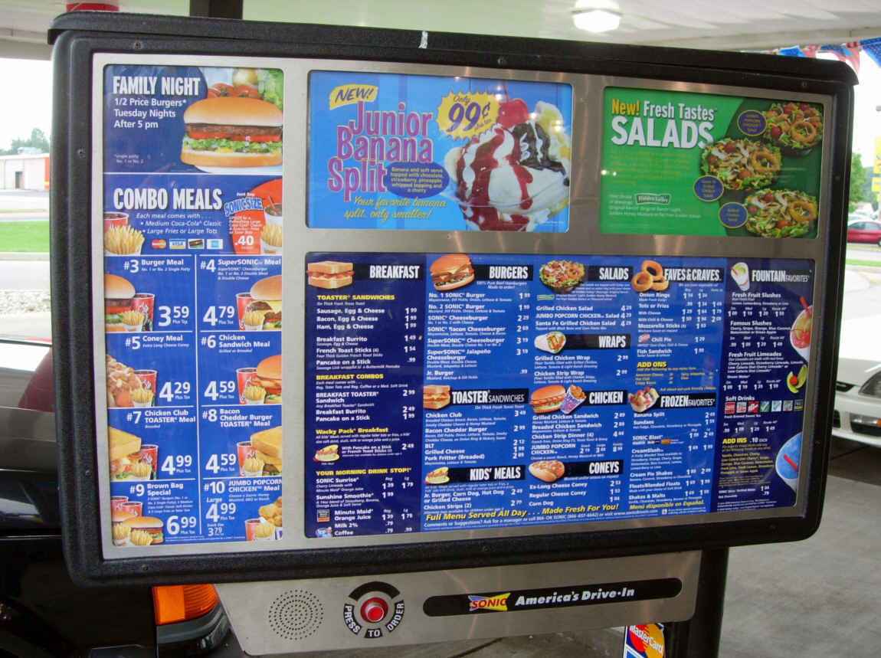
Sonic

Slide 20
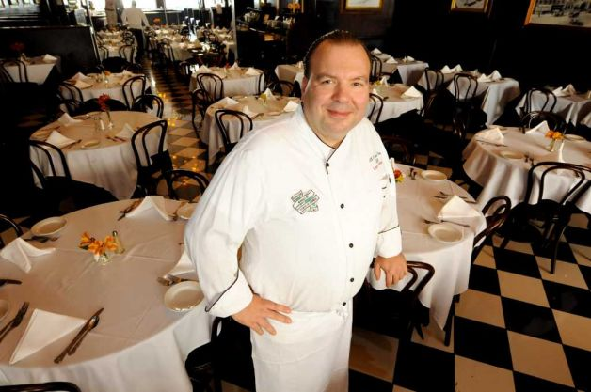
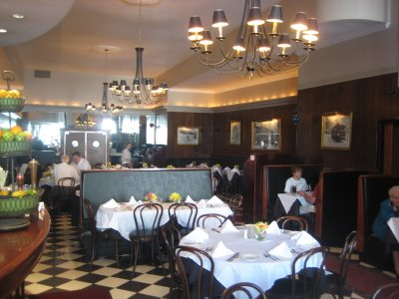
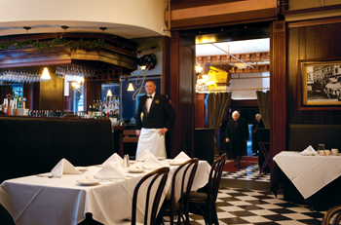
Jack’s Oyster House, Albany NY

Slide 21
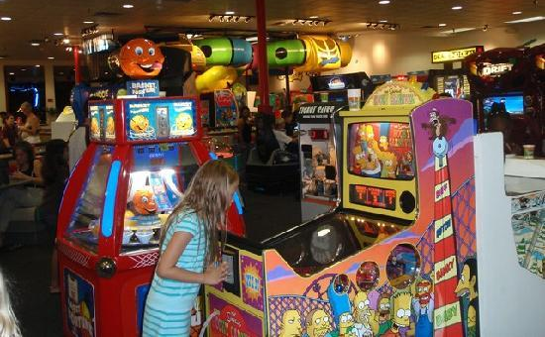
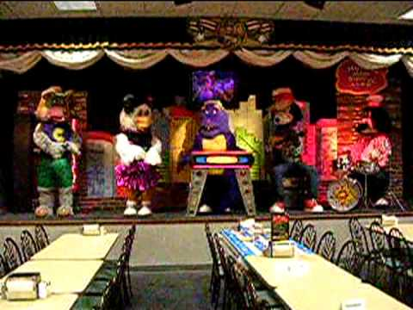
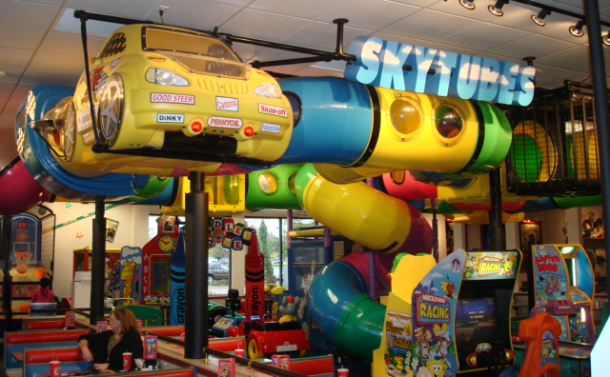
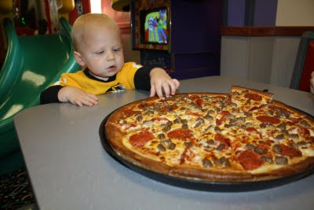
Chuck E. Cheese

Slide 22
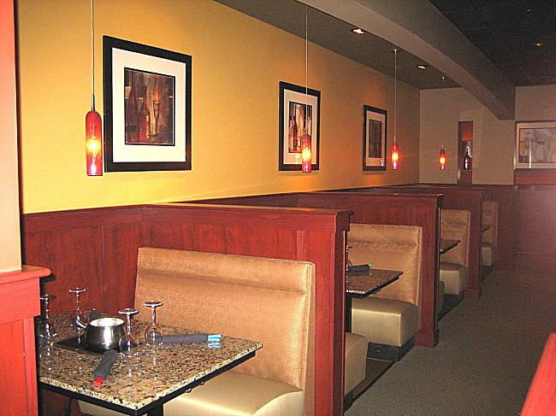
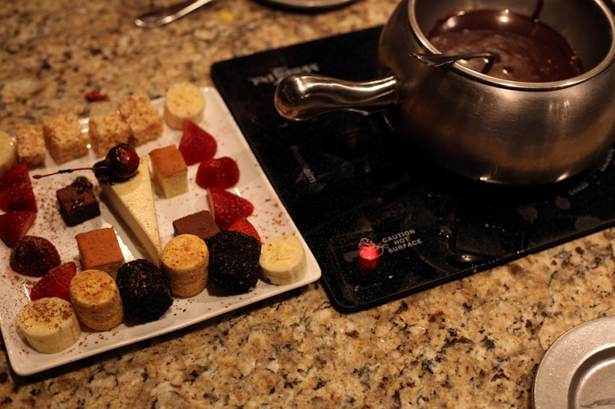
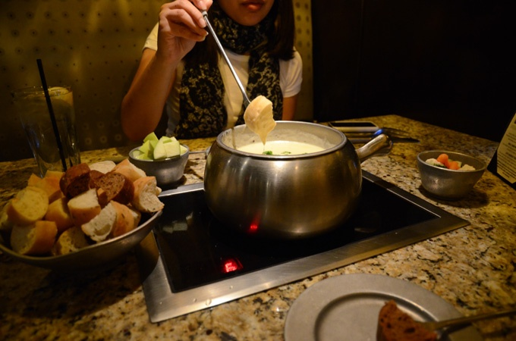
The Melting Pot

Slide 23
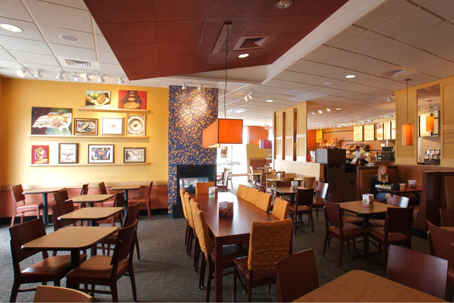
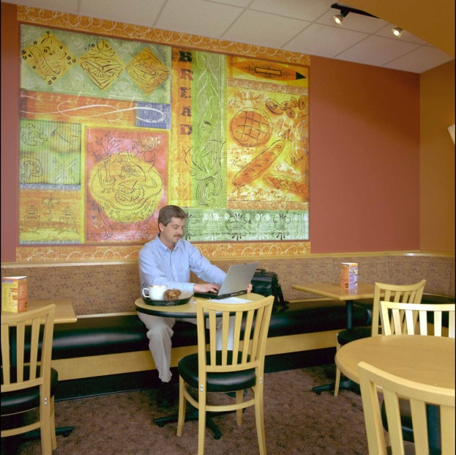
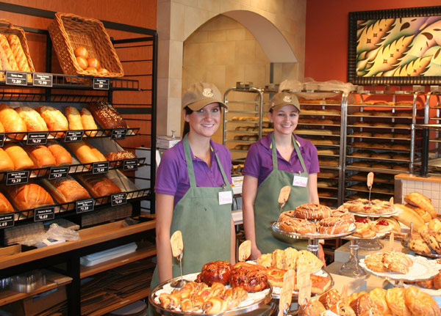
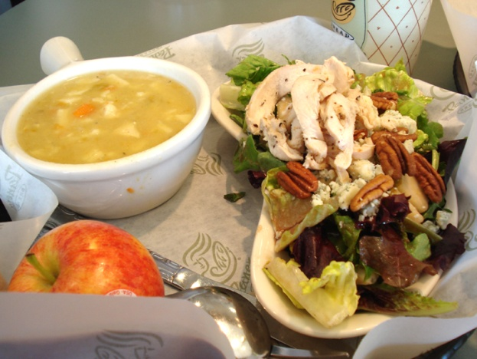
Panera Bread

Slide 24
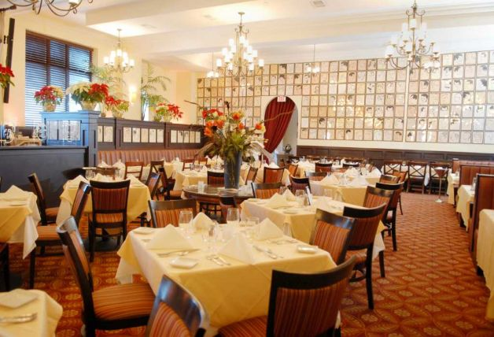
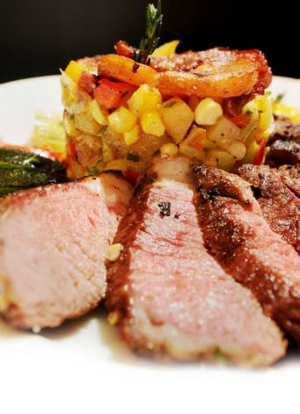
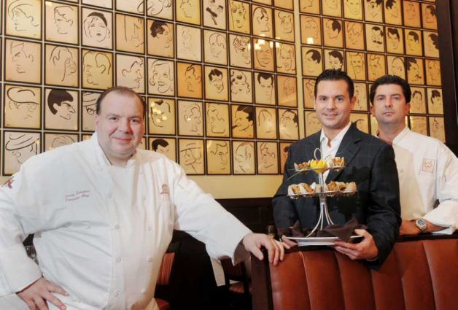
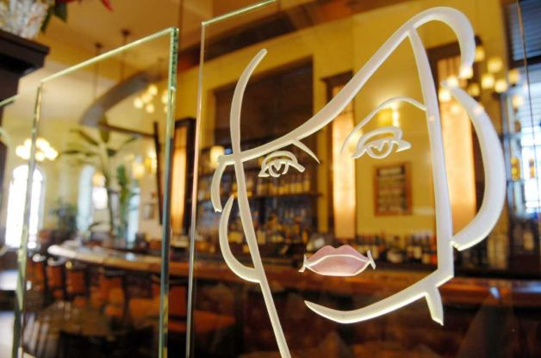
The Brown Derby, Albany NY

Slide 25
Designing your Restaurant
Congratulations again on deciding to open your own restaurant!
What decisions have you already made?
What decisions do you still have to make?
Fill in corresponding brainstorm worksheet to help
Will your restaurant be ready by opening day? (Due date for project __________)

Slide 26
What’s Due?
Brainstorm worksheet
Real Estate worksheet
CABA Application
Name & Logo
Food Worksheet
Menu
Commercial
Dish off your Menu for Tasting

